Slide 1


David Zacher
2/25/2024

Slide 2

Outline
Executive Summary
Introduction
Methodology
Results
Conclusion
Appendix

Slide 3
Executive Summary
Summary of methodologies
Data collection
Data wrangling
Exploratory Data Analysis with SQL
Exploratory Data Analysis with Data Visualization
Building an interactive map with Folium
Building a Dashboard with Plotly Dash
Predictive Analysis (Classification)
Summary of all results
Exploratory Data Analysis results
Interactive analytics demo in screenshots
Predictive analysis results

Slide 4

Introduction
Project background and context
In this project we will predict if the Falcon 9 first stage will land successfully. SpaceX advertises Falcon 9 rocket launches on its website, with a cost of 62 million dollars; other providers cost upward of 165 million dollars each, much of the savings is because SpaceX can reuse the first stage. Therefore, if we can determine if the first stage will land, we can determine the cost of a launch. This information can be used if an alternate company wants to bid against SpaceX for a rocket launch.
Problems we want to find answers to
- How do variables such as payload mass, launch site, number of flights, and orbits affect the success of the first stage landing?
- What is the best algorithm that can be used for binary classification in this case?

Slide 5

Section 1

Slide 6
Methodology
Executive Summary
Data collection methodology:
Using SpaceX Rest API
Using Web Scrapping from Wikipedia
Perform data wrangling
Filtering the Data
Dealing with missing values
Perform exploratory data analysis (EDA) using visualization and SQL
Perform interactive visual analytics using Folium and Plotly Dash
Perform predictive analysis using classification models
Building, tuning, and evaluation of classification models to ensure the best results

Slide 7
Data Collection
The data collection process entailed utilizing a blend of API requests from SpaceX's REST API and web scraping from a table within SpaceX's Wikipedia page. Employing both methods was necessary to acquire comprehensive launch information for a more thorough analysis.
Data Columns are obtained by using SpaceX REST API:
FlightNumber, Data, BoosterVersion, PayloadMass, Orbit, LaunchSite, Outcome, Flights, GridFins, Reused, Legs, LandingPad, Block, ReusedCount, Serial, Longitude, Latitude
Data Columns are obtained by using Wikipedia Web Scraping:
Flight No., Launch sire, Payload, PatloadMass, Orbit, Customer, Launch outcome, Version Booster, Booster landing, Date, Time

Slide 8
Data Collection – SpaceX API
Requesting rocket launch data from SpaceX API
Decoding the response content using .json() and turning it into a data frame using .json_normalize()
Requesting needed information about the launches using SpaceX API
Constructing data, we have obtained into a dictionary
Replacing missing values of Payload Mass column with calculated .mean() for this column
Filtering the data frame to only include the Falcon 9 launches
Creating a data frame from the dictionary
Exporting the data to CSV file
GitHub: Data Collecting

Slide 9
Data Collection – Web Scraping
Creating a BeautifulSoup object from the HTML response
Requesting Falcon 9 launch data from Wikipedia
Extracting all column names from the HTML table header
Collecting the data by parsing HTML tables
Constructing the data we have obtained into a dictionary
Exporting the data to CSV
Creating a data frame from the dictionary
GitHub: Web Scraping

Slide 10
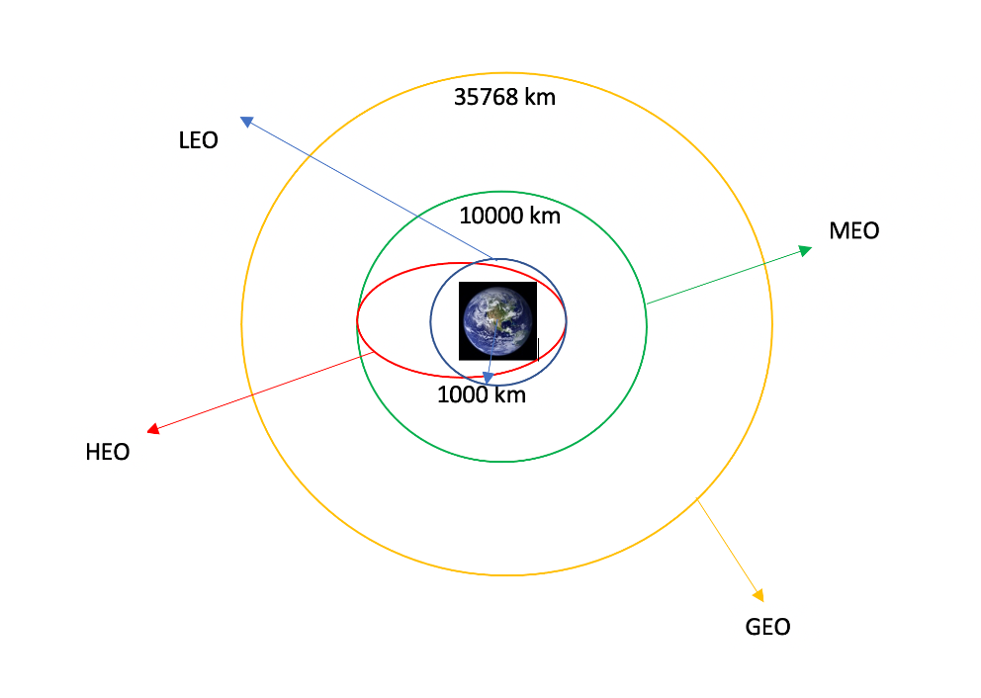
Data Wrangling
Performed exploratory data analysis and determined the training labels
Calculated the number of launches at each site, and the number and occurrence of each orbits
Created landing outcome label from outcome column and exported the results into a csv
GitHub: Data Wrangling

Slide 11
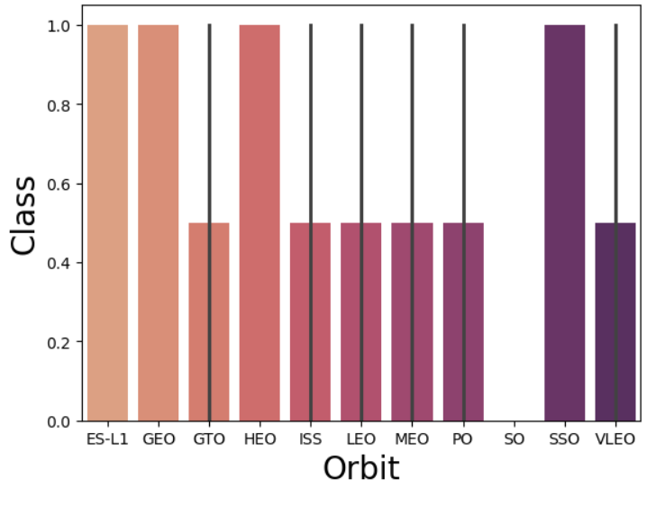
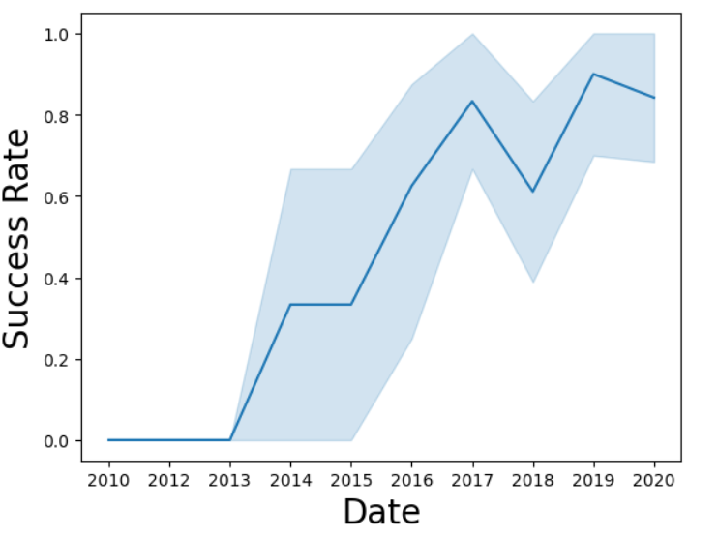
EDA with Data Visualization
We investigated the data by creating visual representation of various relationships, including the correlation between flight number and launch site, payload and launch site, success rate across different orbit types, flight number, and orbit types, as well as the annual trend in launch success rates.
GitHub: Data Visualization

Slide 12

EDA with SQL
We loaded the SpaceX dataset into a PostgreSQL database without leaving the jupyter notebook
We applied EDA with SQL to get insight from the data. We wrote queries to find out for instance:
- The names of unique launch sites in the launch missions
- The total payload mass carried by boosters launched by NASA (CRS)
- The average payload mass carried by booster version F9 v1.1
- The total number of successful and failure mission outcomes
- The failed landing outcome in drone ship, their booster version, and launch site names

Slide 13
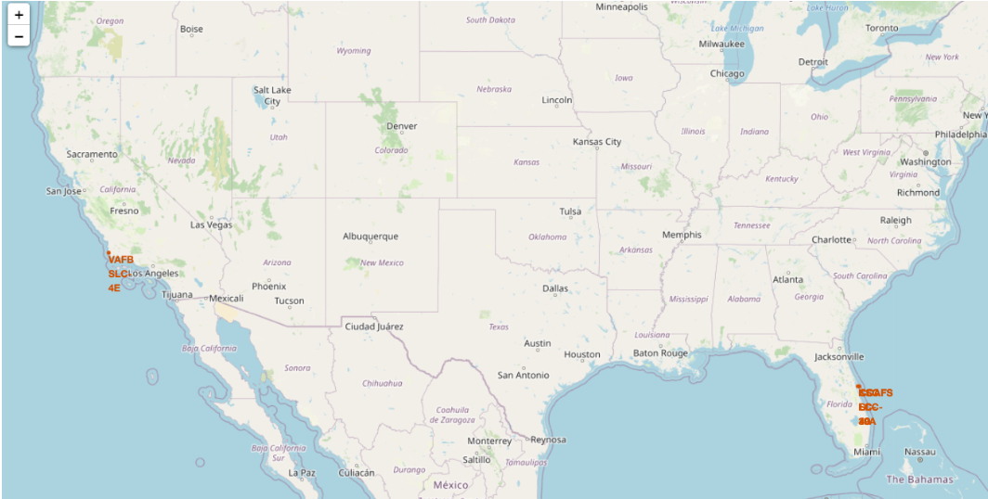
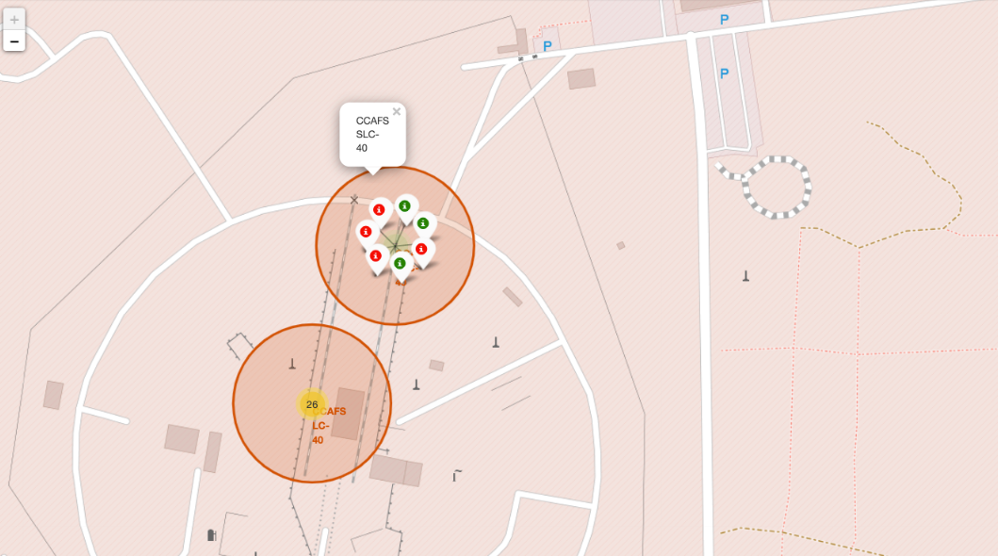
Build an Interactive Map with Folium
We marked all launch sites, and added map objects such as markers, circles, lines to mark the success of failure of launches for each site on the folium map.
We assigned the feature launch outcomes, failure or success, to class 0 and 1. 0 for being a failure, and 1 for success.
Using the color-labeled marker clusters, we identified which launch sites have relatively high success rate.
We then calculated the distance between a launch site to its proximities. We answered some questions for instance:
- Are the launch sites near railways, highways or coastlines?
- Do launch sites keep certain distance away from cities?

Slide 14
Build a Dashboard with Plotly Dash
Built an interactive dashboard with Plotly dash
Plotted pie charts showing the total launches by certain sites
Plotted scatter graph showing the relationship with Outcome and Payload Mass(kg) for the different booster version
Git Hub: Dash App

Slide 15
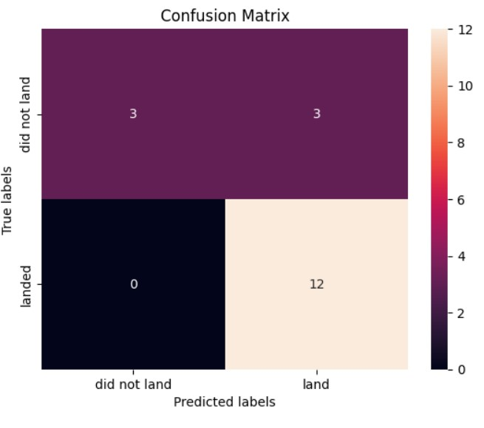
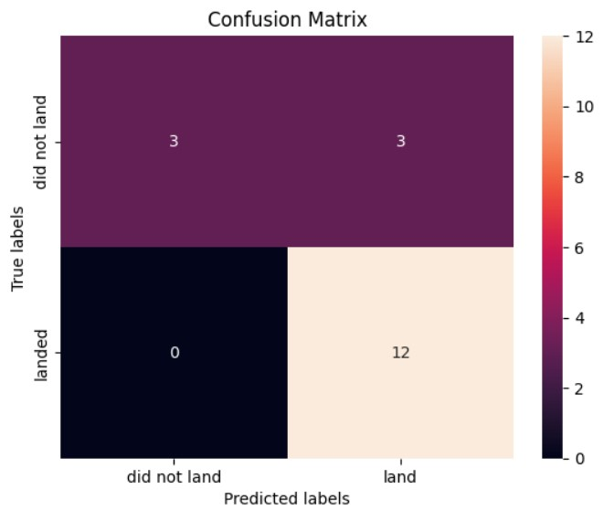
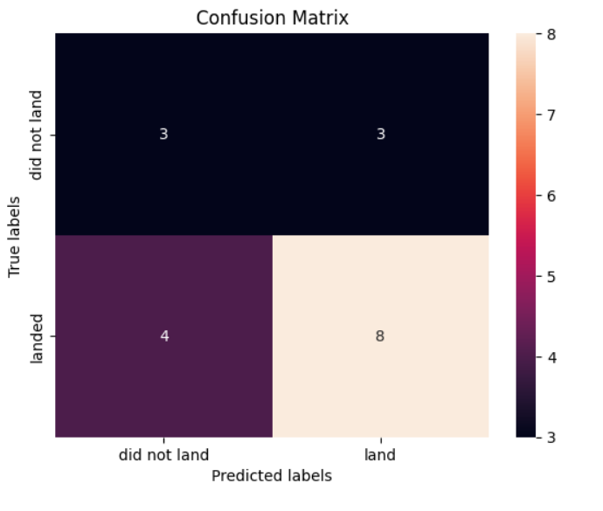
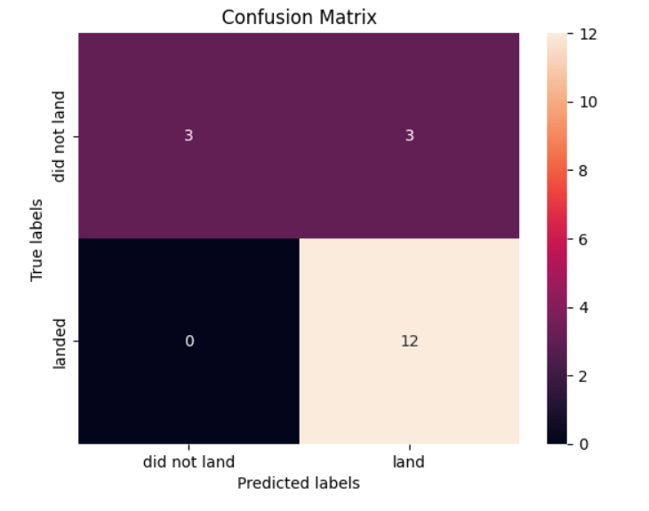
Logistic Regression
SVC
Predictive Analysis (Classification)
We loaded the data using NumPy and pandas, transformed the data, split our data into training and testing.
We built different machine learning models and tune different hyperparameters using GridSearchCV.
We used accuracy as the metric for our model, improved the model using feature engineering and algorithm tuning.
We found the best performing classification model.
Decision Tree Classifier
K Nearest Neighbor

Slide 16
Results
Exploratory data analysis results
Interactive analytics demo in screenshots
Predictive analysis results

Slide 17

Section 2

Slide 18
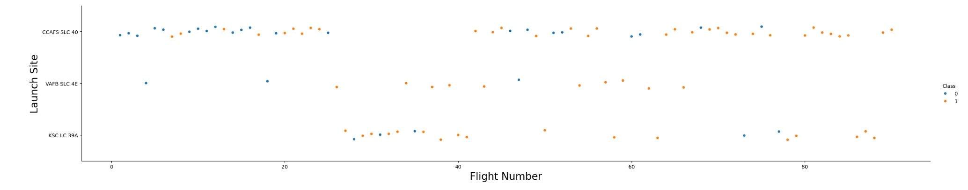
Flight Number vs. Launch Site
Here we can see that as time progresses and the flight numbers increase, the successful launch rates increase

Slide 19
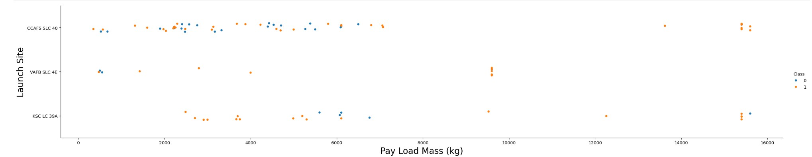
Payload vs. Launch Site
Here we can see that on launch site VAFB-SLC, there are no rockets launched for heavy payload mass(greater than 10000).

Slide 20
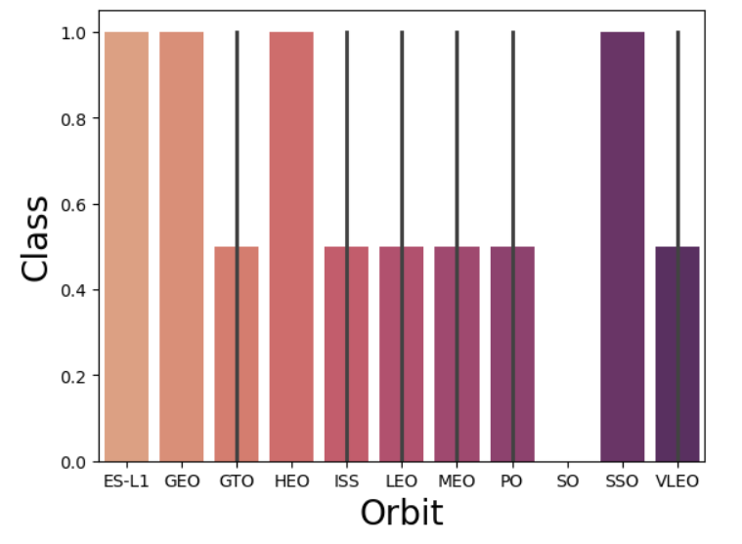
Success Rate vs. Orbit Type
From the plot we can that ES-L1, GEO, HEO, and SSO had the most success rate
20

Slide 21
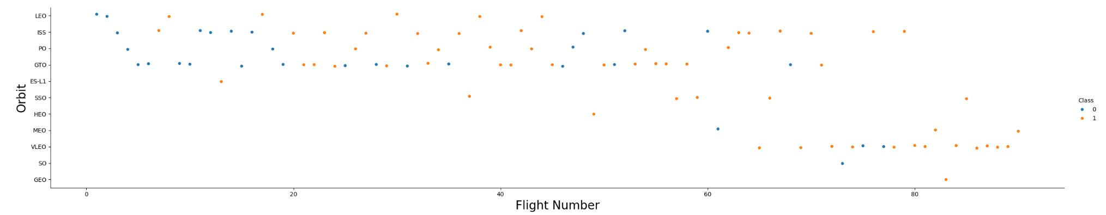
Flight Number vs. Orbit Type
Here we can see that for LEO orbit, the success rate for this is based on the number of flights; while on the other hand, there seems to be no relationship with the GTO orbit and flight numbers. VLEO seems to succeed with more flights.

Slide 22
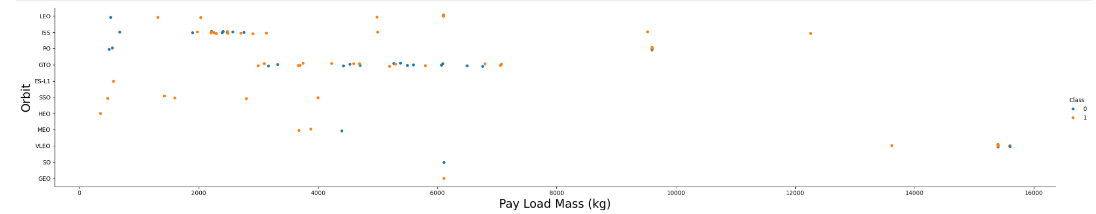
Payload vs. Orbit Type
With heavy payloads the successful landing or positive landing rate are more for Polar, LEO and ISS.
However, for GTO we cannot distinguish this well as both positive landing rate and negative landing(unsuccessful mission) are both there here.

Slide 23
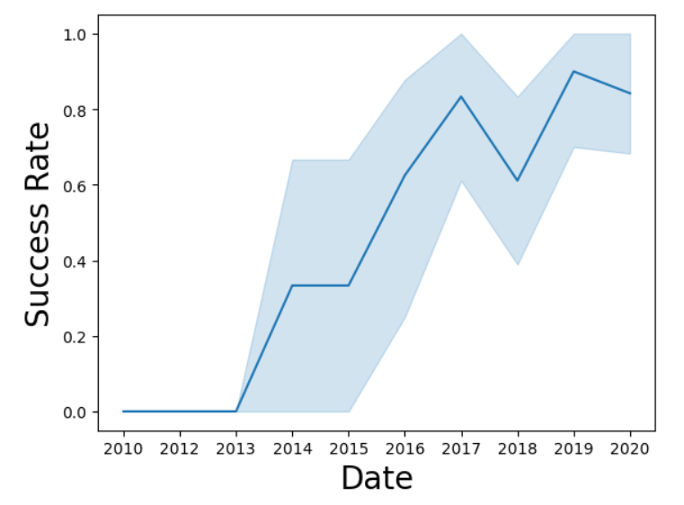
Launch Success Yearly Trend
Here we see that after 2013, the success rate kept increasing

Slide 24
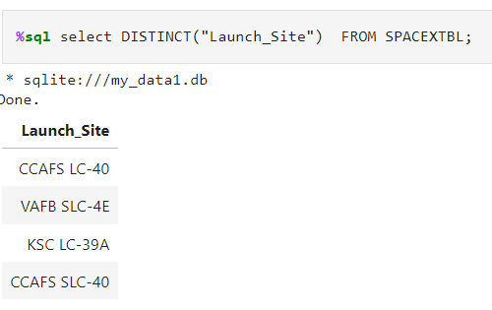
All Launch Site Names
We used the key word DISTINCT to show only unique launch sites from the SpaceX data
24

Slide 25
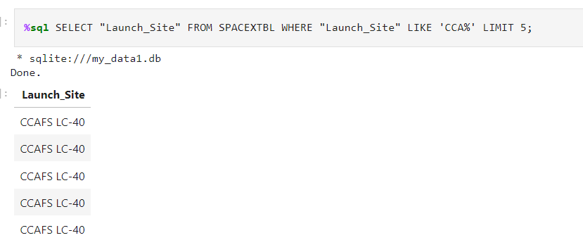
Launch Site Names Begin with 'CCA'
We wanted to find the launch sites that started with “CCA” using the LIKE function

Slide 26
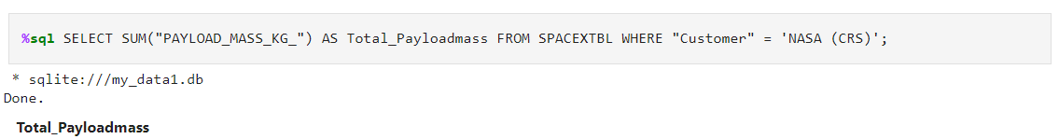
Total Payload Mass
We calculated the total payload carried by boosters from NASA

Slide 27
Average Payload Mass by F9 v1.1
We calculated the average payload mass carried by booster version F9 v1.1

Slide 28
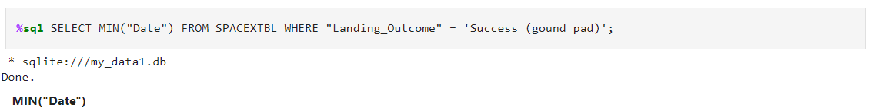
First Successful Ground Landing Date
Find the dates of the first successful landing outcome on ground pad
Present your query result with a short explanation here

Slide 29
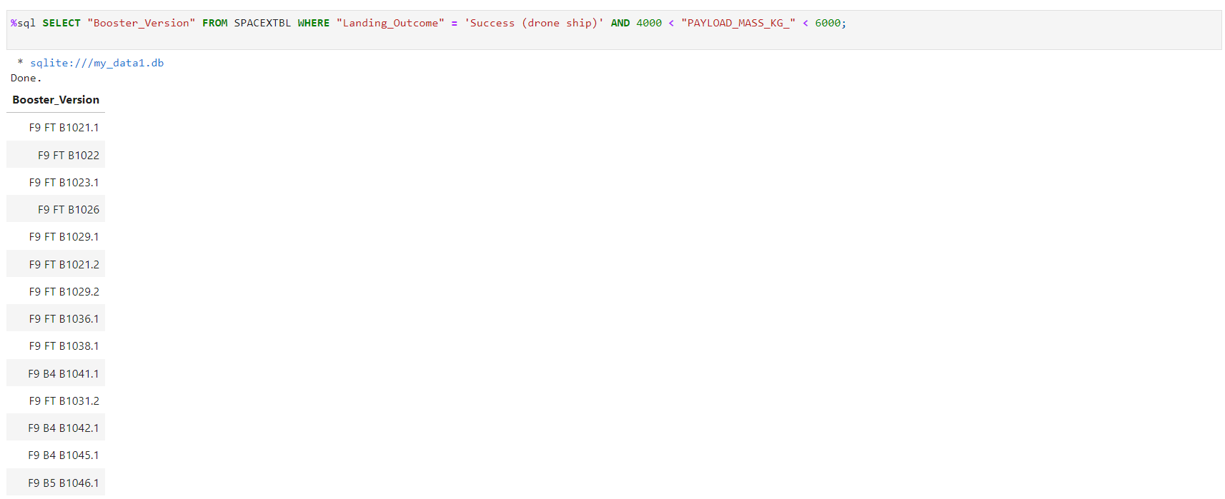
Successful Drone Ship Landing with Payload between 4000 and 6000
We used the WHERE clause to filter for boosters which have successfully landed on drone ship and applied the AND condition to determine successful landing between payload mass 4000 and 6000

Slide 30
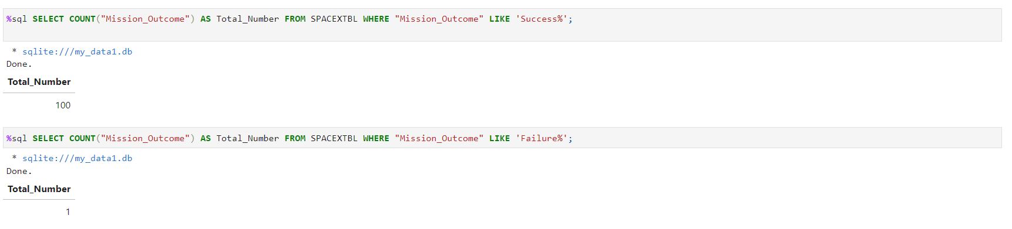
Total Number of Successful and Failure Mission Outcomes
We used wildcard like ‘%’ to filter for WHERE Mission_Outcome was a success or a failure.

Slide 31
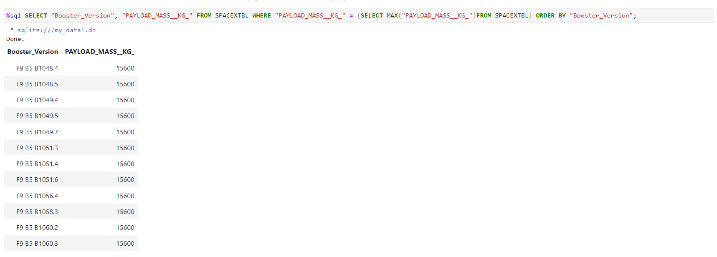
Boosters Carried Maximum Payload
We found out which boosters carried that max amount of payload with the MAX function and creating a subquery.

Slide 32
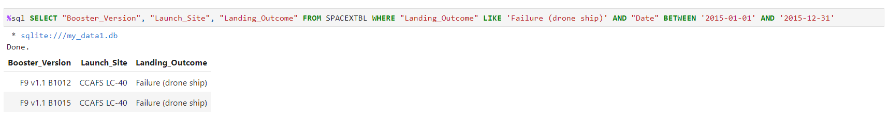
2015 Launch Records
We listed the failed landing_outcomes in drone ship, their booster versions, and launch site names for in year 2015

Slide 33
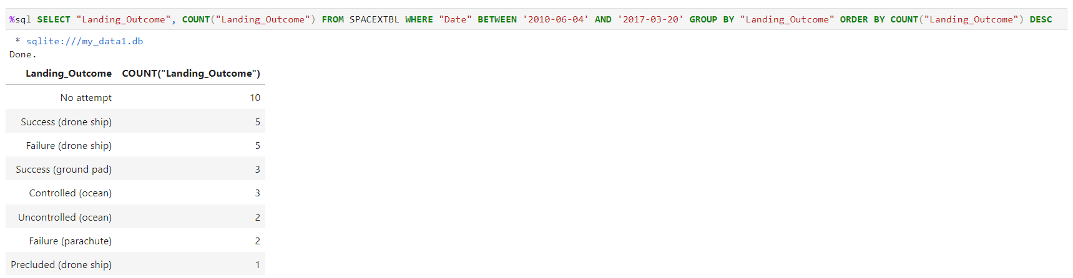
Rank Landing Outcomes Between 2010-06-04 and 2017-03-20
Ranked the count of landing outcomes (such as Failure (drone ship) or Success (ground pad)) between the date 2010-06-04 and 2017-03-20, in descending order

Slide 34

Section 3

Slide 35
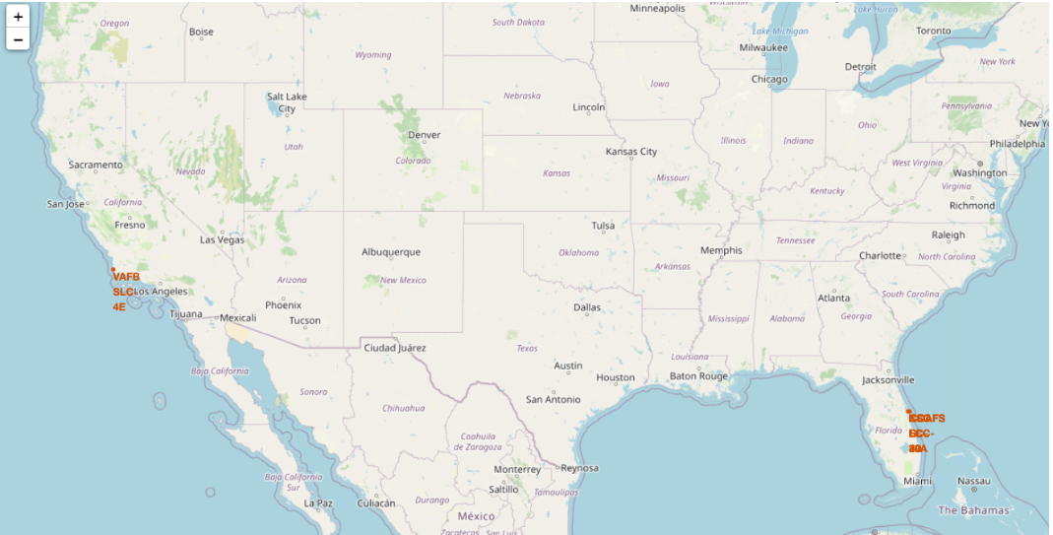
All the launch sites

Slide 36
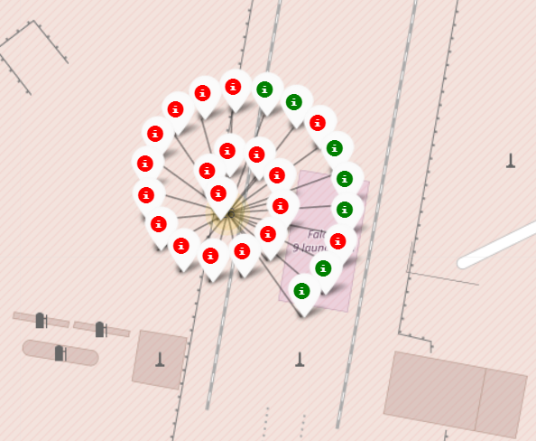
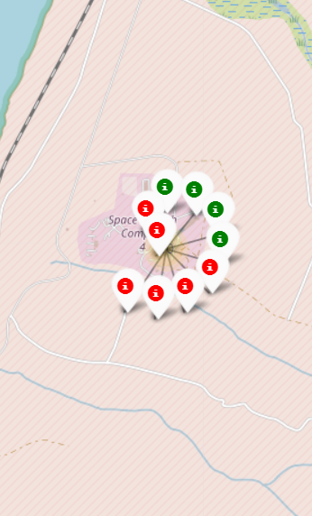
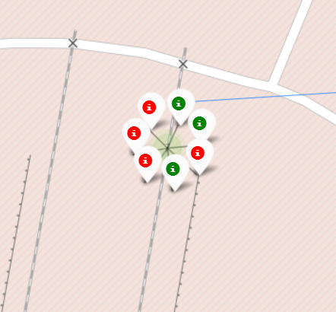
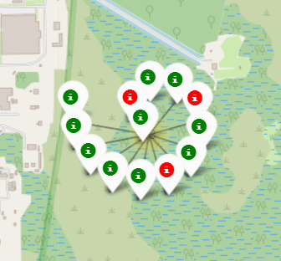
Markers showing launch sites with color labels
Florida launch sites
Green marker shows successful launches and Red marker shows failures
California launch site

Slide 37
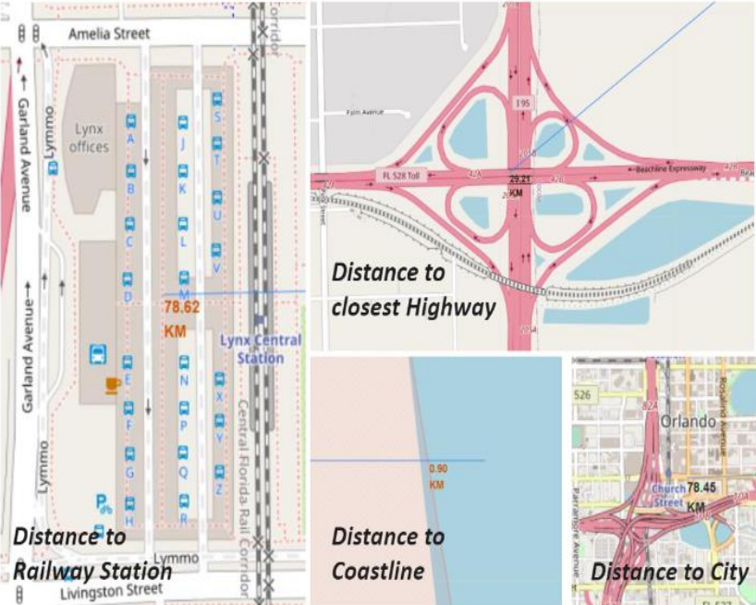
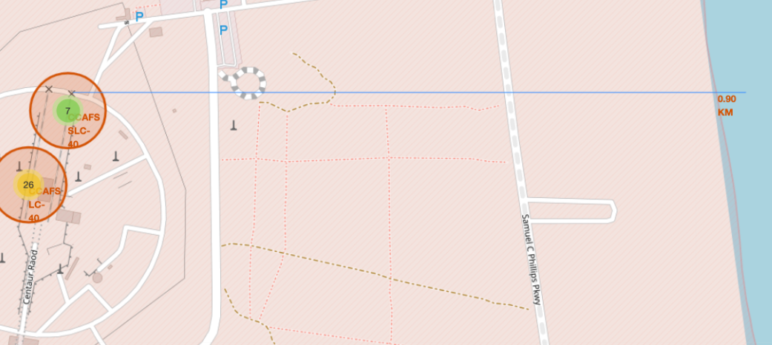
Launch site distance to landmarks
Distance to coastline

Slide 38

Section 4

Slide 39
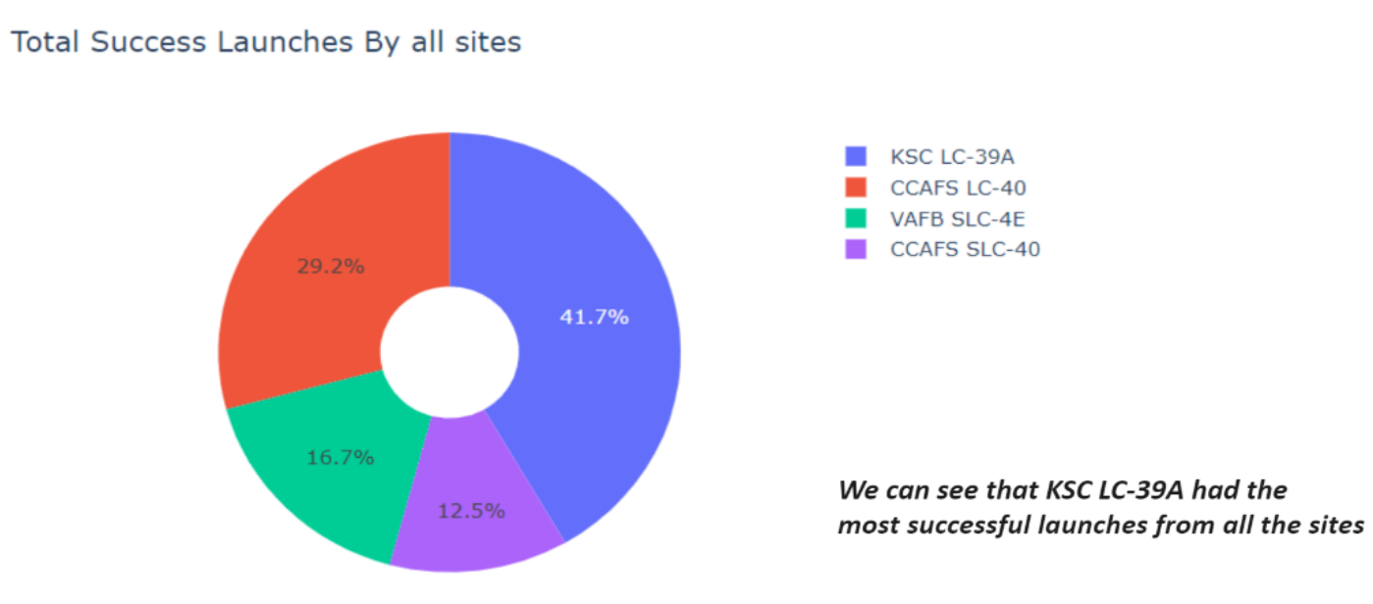
Success percentage achieved by each launch site

Slide 40
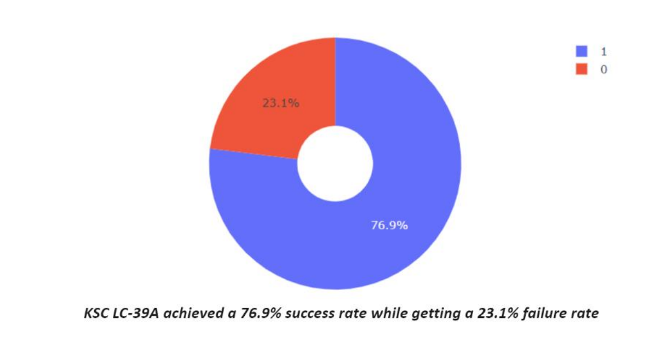
Launch site with the highest launch success ratio

Slide 41
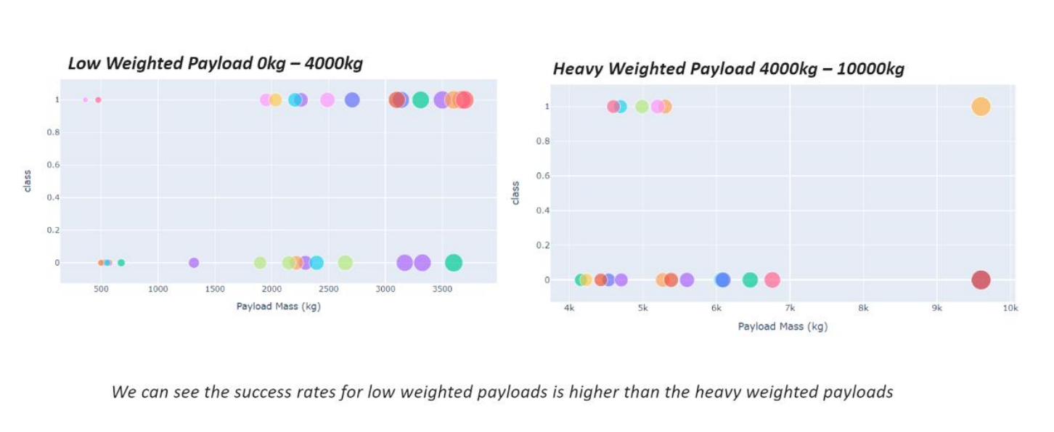
Payload vs Launch Outcome for all sites

Slide 42

Section 5

Slide 43
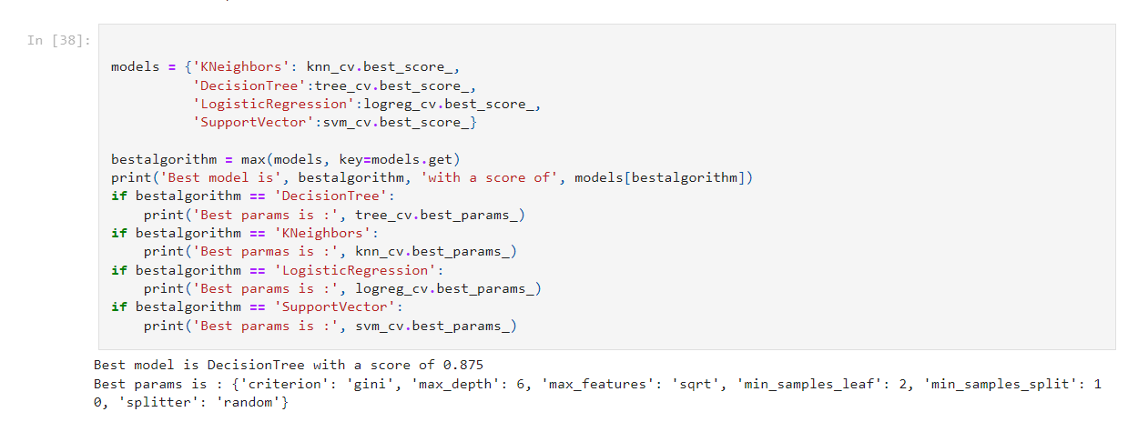
Classification Accuracy
The decision tree classifier is the model with the highest classification accuracy
43

Slide 44
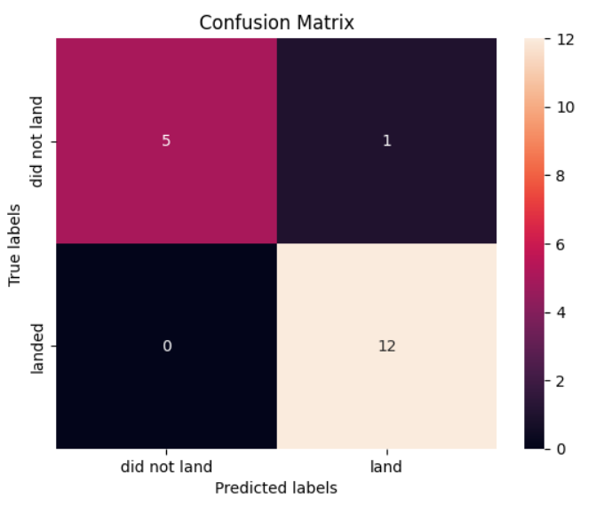
Confusion Matrix
The confusion matrix for the decision tree classifier shows that the classifier can distinguish between the different classes. The major problem is the false positives

Slide 45
Conclusions
The larger the flight amount at a launch site, the greater the success rate at a launch site.
Launch success rate started to increase in 2013 till 2020.
Orbits ES-L1, GEO, HEO, SSO, VLEO had the most success rate.
KSC LC-39A had the most successful launches of any sites.
The Decision tree classifier is the best machine learning algorithm for this task.

Slide 46


